Slide 1

Natural Language Processing
Yue Zhang
Westlake University

Slide 2
Overview
Week 2
Overview of NLP architecture
Data and Model
Review of background
Linear Models
Week 3
Week 4
Week 5
Week 6
Week 7
N-gram Language Models
Naïve Bayes
Generative Text Classification
Features
Document Representation
Discriminative Text Classification
Neuron
SGD
Entropy, Perplexity
Word Representation
HMM -- Generative Sturctured Prediction
CRF – Discriminative Structured Prediction
Neural Models
Week 8
Week 10
Week 12
MLP, Multi-Layer Perception
Neural N-gram LM and Word Embedding
Neural Structured Prediction
Sequence-to-sequence
Neural Recurrent Language Models
Week 9
Week 13
Sequence Representation
Neural Text Classification
Week 11
Sequence-level Pre-training
Pre-trained Models for Text Classification and other NLP tasks
Structured Representation
Large Language Models
Week 14
Week 15
Scaling, instruction following and LLMs
LLMs for NLP, AGI and beyond

Slide 3

Week 3
Counting Relative Frequencies

Slide 4
Contents
3.1 Probabilistic Modelling
  3.1.1 Maximum Likelihood Estimation (MLE)
  3.1.2 Modelling the Probability of Words
3.2 N-gram Language Models
  3.2.1 Unigram Language Models
  3.2.2 Bigram Language Models
  3.2.3 Trigram Language Models and Beyond
  3.2.4 Generative Models
3.3 Naïve Bayes Text Classification
  3.3.1 Naïve Bayes Text Classification
  3.3.2 Features

Slide 5
Models
What is a “ model”:
  An imaginary abstract and simplified version of a subject
  Makes mathematical calculation feasible
Probabilistic model:
  Calculate the probability of a random event
Take coin tossing for example:
  abstract away factors
models. P(head), P(tail)

Slide 6
Contents
3.1 Probabilistic Modelling
  3.1.1 Maximum Likelihood Estimation (MLE)
  3.1.2 Modelling the Probability of Words
3.2 N-gram Language Models
  3.2.1 Unigram Language Models
  3.2.2 Bigram Language Models
  3.2.3 Trigram Language Models and Beyond
  3.2.4 Generative Models
3.3 Naïve Bayes Text Classification
  3.3.1 Naïve Bayes Text Classification
  3.3.2 Features

Slide 7
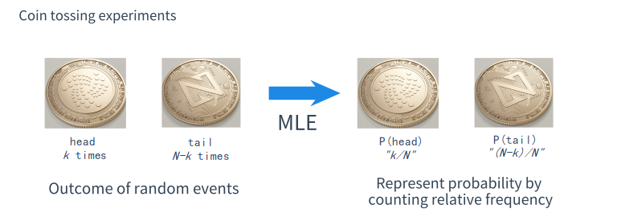
Coin Tossing — Counting Relative Frequencies
What we do intuitively

Slide 8
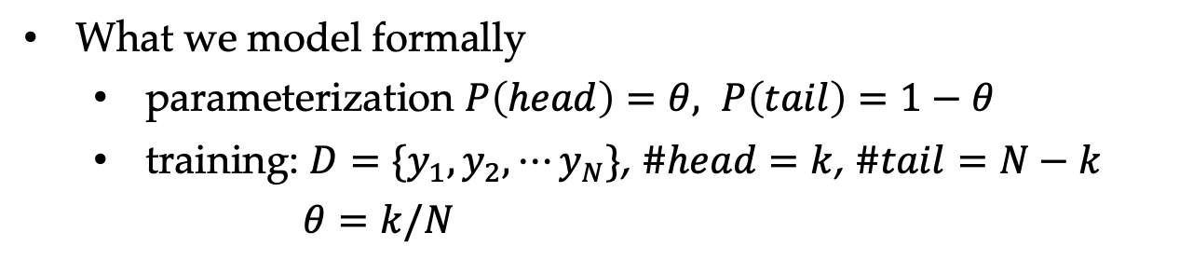
Coin Tossing — Counting Relative Frequencies
What we do intuitively
What we model formally
  parameterization $P\left(head\right)=θ, P\left(tail\right)=1−θ$
  training: $D=\{y_{1},y_{2},⋯y_{N}\}$, $\#head=k$, $\#tail=N−k$
  $θ=k/N$

Slide 9
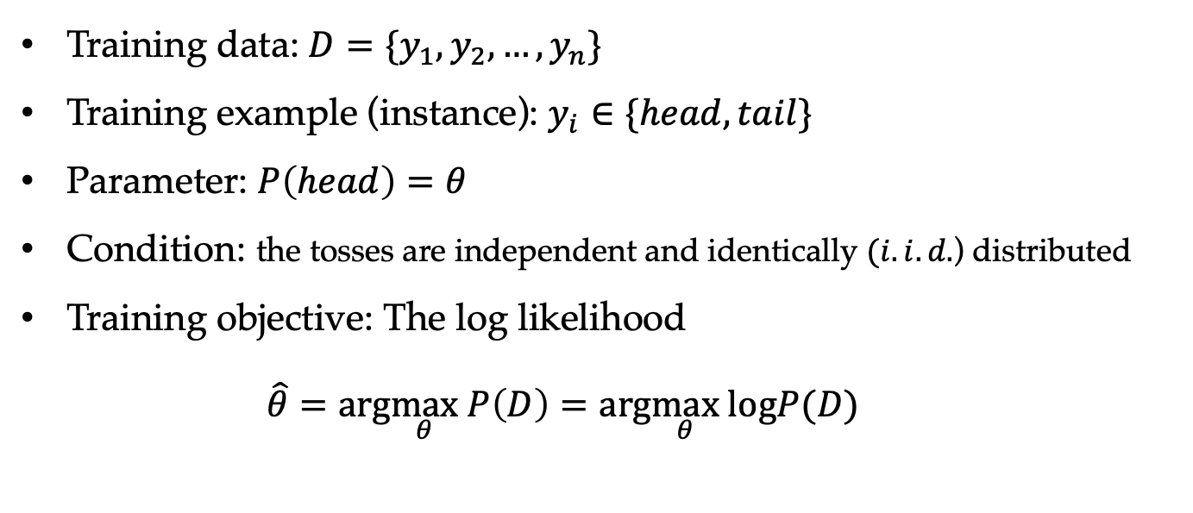
Maximum Likelihood Estimation
Training data: $D=\{y_{1},y_{2},…,y_{n}\}$
Training example (instance): $y_{i}∈\{head, tail\}$
Parameter: $P\left(head\right)=θ$
Condition: the tosses are independent and identically $(i.i.d.$) distributed
Training objective: The log likelihood
  $$\hat{θ}=arg\max_{θ} P\left(D\right)=arg\max_{θ} logP(D)$$

Slide 10
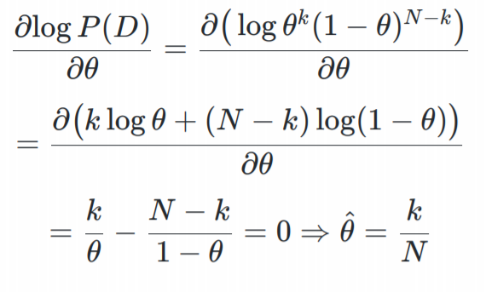
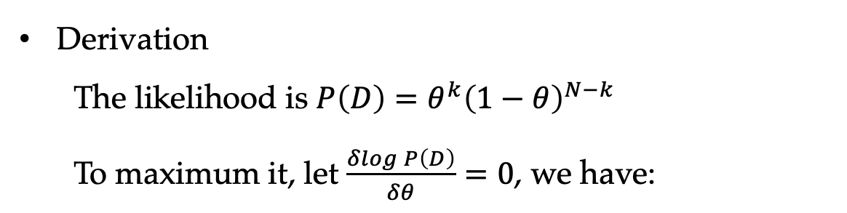
MLE Leads to Counting Relative Frequencies
Derivation
The likelihood is $P\left(D\right)=θ^{k}{\left(1−θ\right)}^{N−k}$
To maximum it, let $\frac{δlogP\left(D\right)}{δθ}=0$, we have:

Slide 11
Contents
3.1 Probabilistic Modelling
  3.1.1 Maximum Likelihood Estimation (MLE)
  3.1.2 Modelling the Probability of Words
3.2 N-gram Language Models
  3.2.1 Unigram Language Models
  3.2.2 Bigram Language Models
  3.2.3 Trigram Language Models and Beyond
  3.2.4 Generative Models
3.3 Naïve Bayes Text Classification
  3.3.1 Naïve Bayes Text Classification
  3.3.2 Features

Slide 12
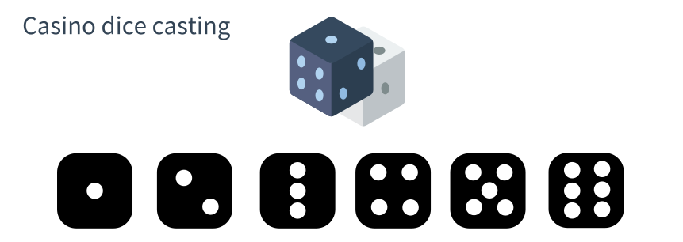
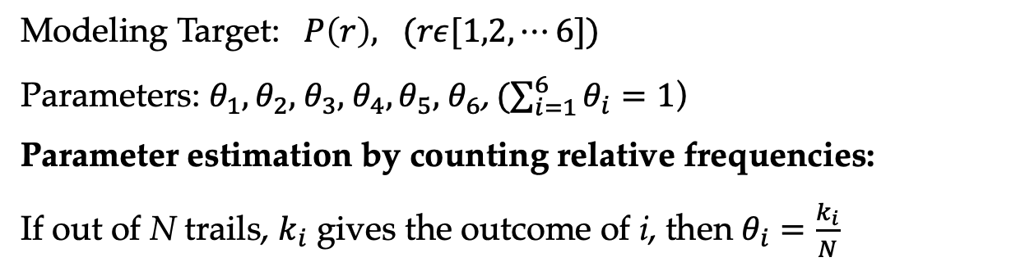
Casino Dice Casting
Modeling Target: $P\left(r\right), (rε[1,2,⋯6])$
Parameters: $θ_{1},θ_{2},$ $θ_{3},$ $θ_{4},θ_{5},$ $θ_{6}$, ($\sum_{i=1}^{6}{θ_{i}}=1$)
Parameter estimation by counting relative frequencies:
If out of N trails, $k_{i}$ gives the outcome of i, then $θ_{i}=\frac{k_{i}}{N}$

Slide 13
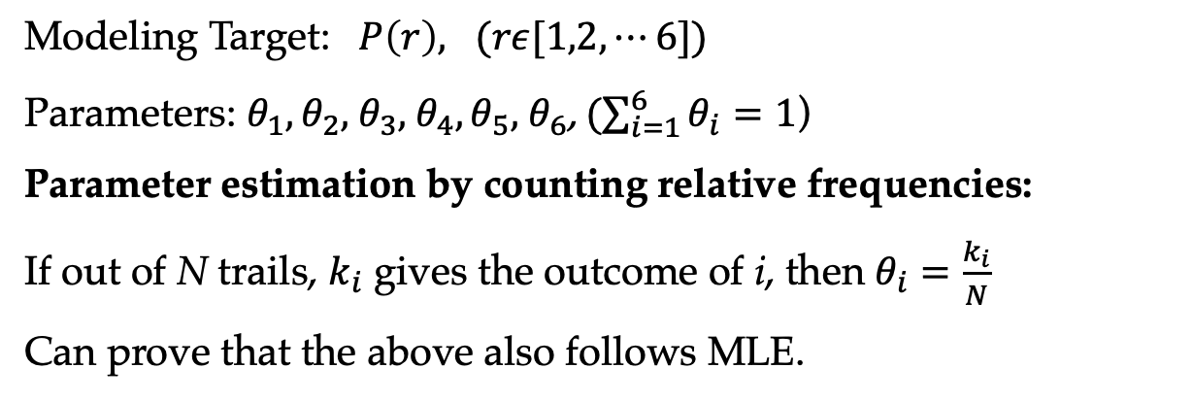
Casino Dice Casting
Modeling Target: $P\left(r\right), (rε[1,2,⋯6])$
Parameters: $θ_{1},θ_{2},$ $θ_{3},$ $θ_{4},θ_{5},$ $θ_{6}$, ($\sum_{i=1}^{6}{θ_{i}}=1$)
Parameter estimation by counting relative frequencies:
If out of N trails, $k_{i}$ gives the outcome of i, then $θ_{i}=\frac{k_{i}}{N}$
Can prove that the above also follows MLE.

Slide 14
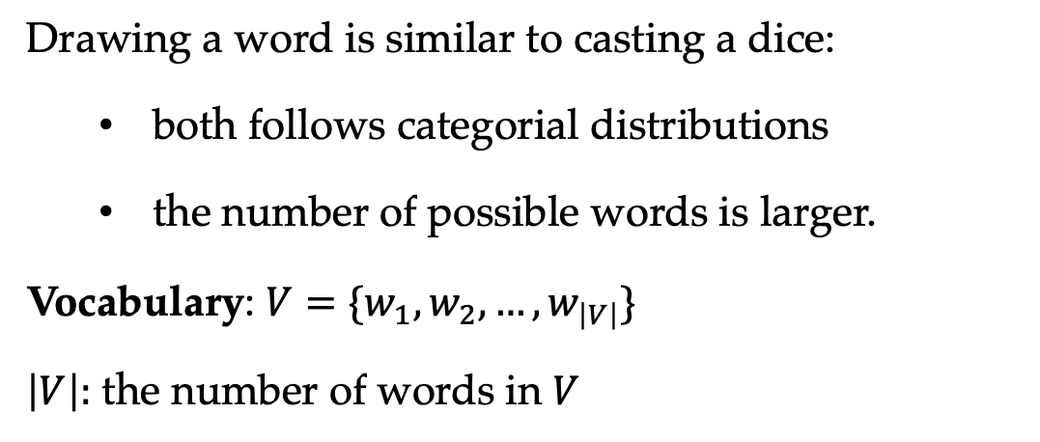
Training a Word Model
Drawing a word is similar to casting a dice:
  both follows categorial distributions
  the number of possible words is larger.
Vocabulary: $V=\{w_{1},w_{2},…,w_{\left|V\right|}\}$
$\left|V\right|:$ the number of words in $V$

Slide 15
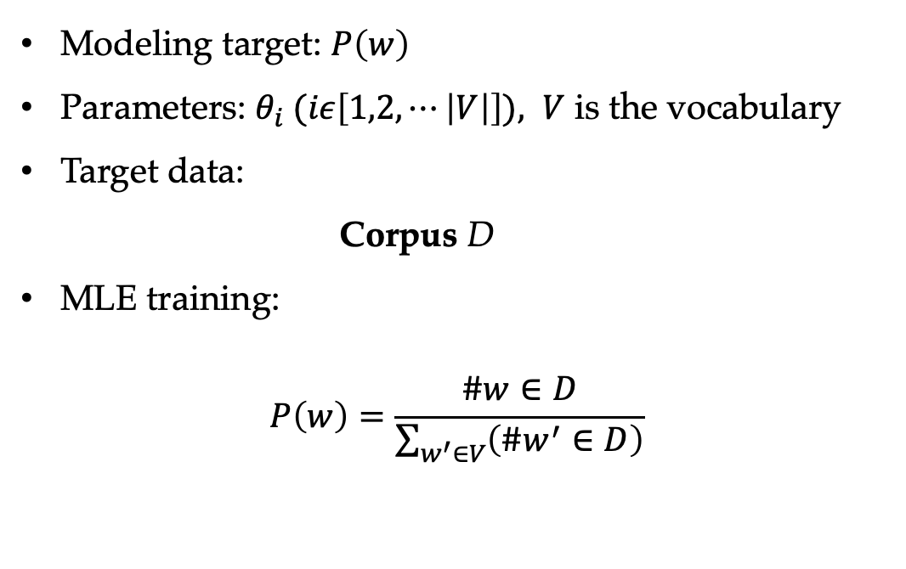
Training a Word Model
Modeling target: $P\left(w\right)$
Parameters: $θ_{i} (iε\left[1,2,⋯\left|V\right|\right]), V$ is the vocabulary
Target data:
Corpus D
MLE training:
$$P\left(w\right)=\frac{\#w∈D}{\sum_{w^{′}∈V}{\left(\#w^{′}∈D\right)}}$$

Slide 16
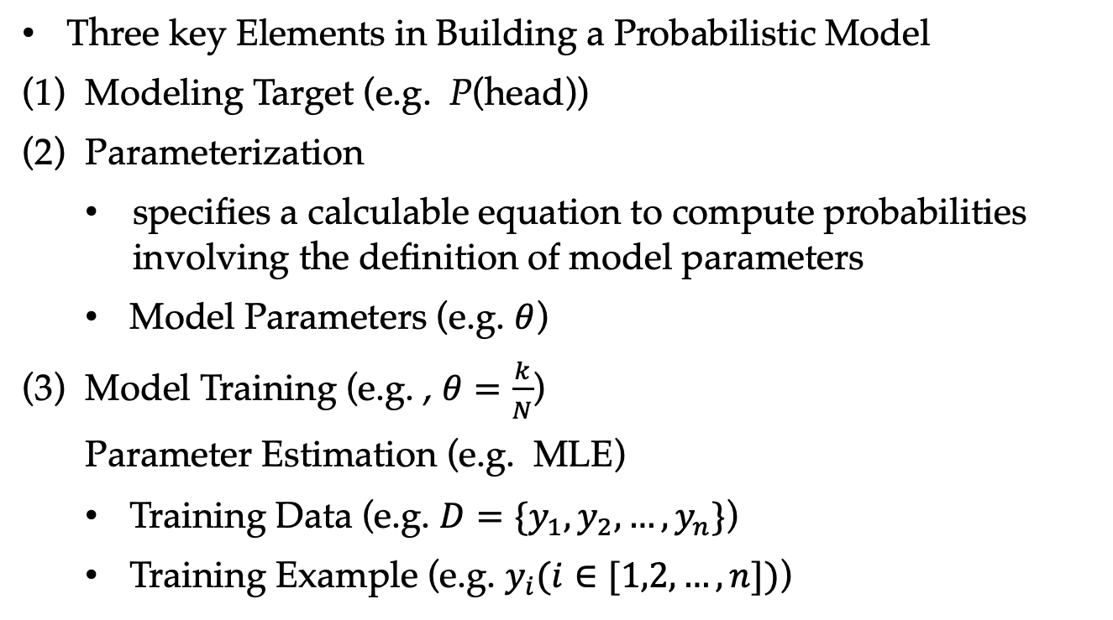
Review
Three key Elements in Building a Probabilistic Model
(1) Modeling Target (e.g. P(head))
(2) Parameterization
  specifies a calculable equation to compute probabilities involving the definition of model parameters
  Model Parameters (e.g. $θ$)
(3) Model Training (e.g. , $θ=\frac{k}{N}$)
Parameter Estimation (e.g. MLE)
  Training Data (e.g. $D=\{y_{1},y_{2},…,y_{n}\}$)
  Training Example (e.g. $y_{i}(i∈[1,2,…,n])$)

Slide 17
Contents
3.1 Probabilistic Modelling
  3.1.1 Maximum Likelihood Estimation (MLE)
  3.1.2 Modelling the Probability of Words
3.2 N-gram Language Models
  3.2.1 Unigram Language Models
  3.2.2 Bigram Language Models
  3.2.3 Trigram Language Models and Beyond
  3.2.4 Generative Models
3.3 Naïve Bayes Text Classification
  3.3.1 Naïve Bayes Text Classification
  3.3.2 Features

Slide 18
Language Model
A language model can be used to analyze or generate natural language sentences.
A probabilistic language model (LM) measures the probability of natural language sentences, by means of simpler patterns, such as:
  words
“thanks” is more probable than “markov”
  phrases
P(“eat pizza”) > P(“drink pizza”)
  sentences
P(“he said hi.”) > P(“said he hi.”)

Slide 19
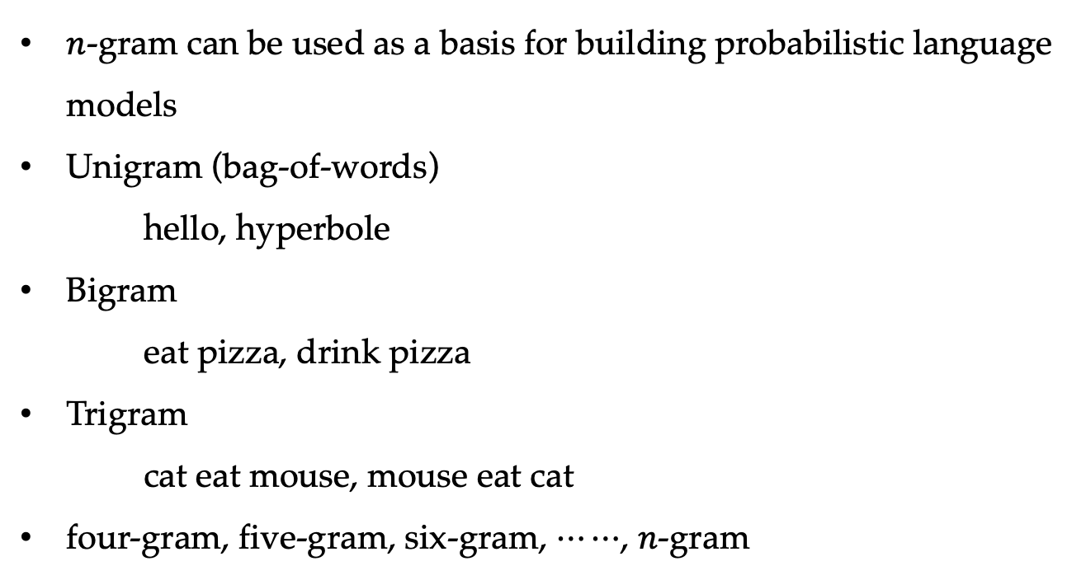
N-gram
$n$-gram can be used as a basis for building probabilistic language models
Unigram (bag-of-words)
hello, hyperbole
Bigram
eat pizza, drink pizza
Trigram
cat eat mouse, mouse eat cat
four-gram, five-gram, six-gram, $⋯⋯$, $n$-gram

Slide 20
Contents
3.1 Probabilistic Modelling
  3.1.1 Maximum Likelihood Estimation (MLE)
  3.1.2 Modelling the Probability of Words
3.2 N-gram Language Models
  3.2.1 Unigram Language Models
  3.2.2 Bigram Language Models
  3.2.3 Trigram Language Models and Beyond
  3.2.4 Generative Models
3.3 Naïve Bayes Text Classification
  3.3.1 Naïve Bayes Text Classification
  3.3.2 Features

Slide 21
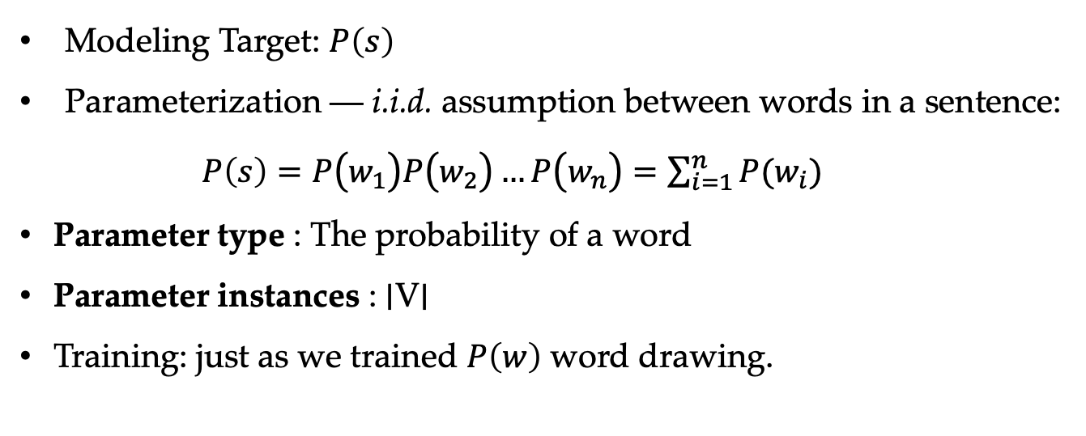
Unigram Language Models
Modeling Target: $P\left(s\right)$
Parameterization — i.i.d. assumption between words in a sentence:
$P\left(s\right)=P\left.\left(w_{1}\right.\right)P\left.\left(w_{2}\right.\right)…P\left.\left(w_{n}\right.\right)=\sum_{i=1}^{n}{P(w_{i})}$
Parameter type : The probability of a word
Parameter instances : ∣V∣
Training: just as we trained $P\left(w\right)$ word drawing.

Slide 22

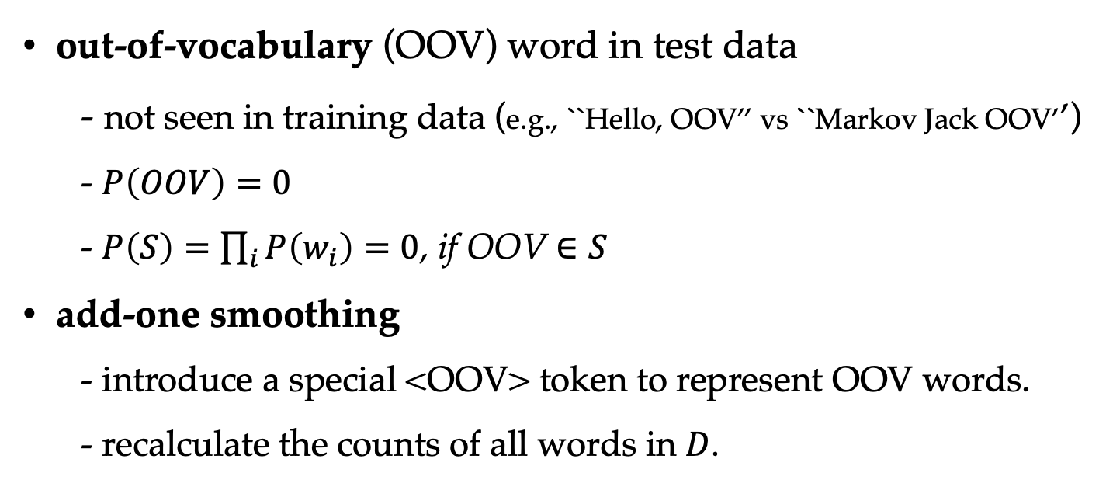
Unigram Language Models
out-of-vocabulary (OOV) word in test data
- not seen in training data (e.g., ``Hello, OOV’’ vs ``Markov Jack OOV’’)
- $P\left(OOV\right)=0$
- $P\left(S\right)=\prod_{i}{P\left(w_{i}\right)=0}$, if OOV $∈S$
add-one smoothing
- introduce a special <OOV> token to represent OOV words.
- recalculate the counts of all words in $D$.

Slide 23
Smoothing
(a) Unigram distributions. (b) Unigram distributions with add-10 smoothing.

Slide 24
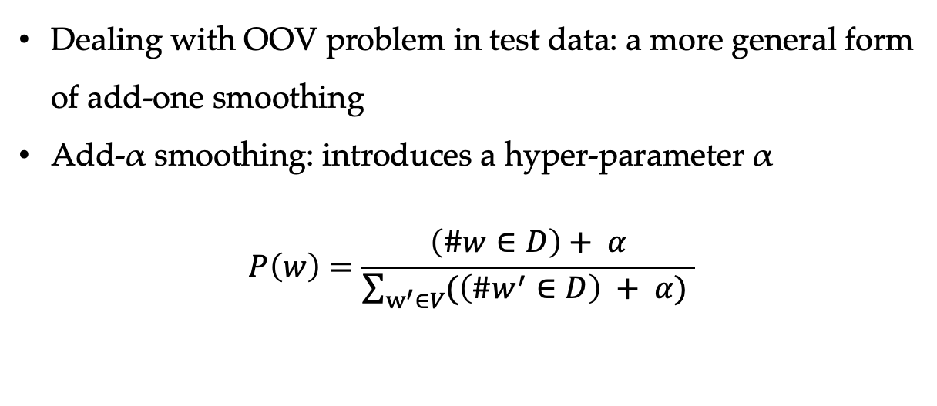
Add-α Smoothing
Dealing with OOV problem in test data: a more general form of add-one smoothing
  Add-α smoothing: introduces a hyper-parameter α
  $$P\left(w\right)=\frac{\left(\#w∈D\right)+ α}{\sum_{w^{′}∈V}{(\left(\#w^{′}∈D\right) + α)} }$$

Slide 25
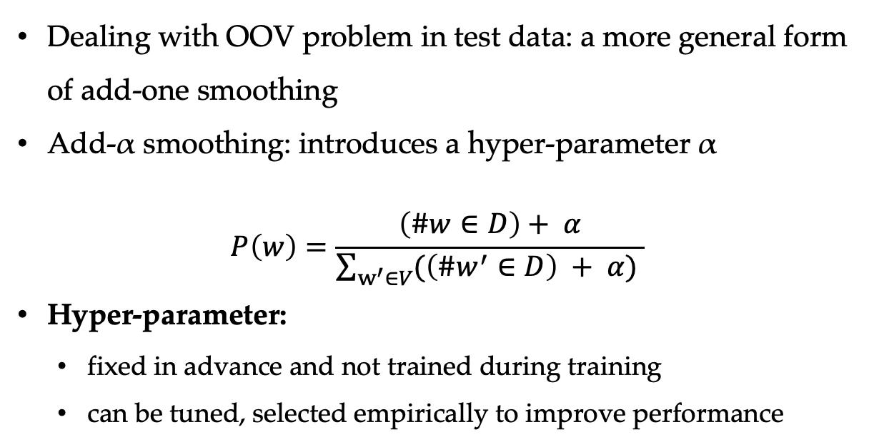
Add-α Smoothing
Dealing with OOV problem in test data: a more general form of add-one smoothing
  Add-α smoothing: introduces a hyper-parameter α
  $$P\left(w\right)=\frac{\left(\#w∈D\right)+ α}{\sum_{w^{′}∈V}{(\left(\#w^{′}∈D\right) + α)} }$$
Hyper-parameter:
  fixed in advance and not trained during training
  can be tuned, selected empirically to improve performance

Slide 26
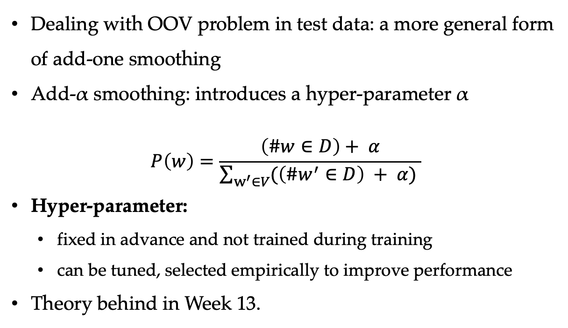
Add-α Smoothing
Dealing with OOV problem in test data: a more general form of add-one smoothing
  Add-α smoothing: introduces a hyper-parameter α
  $$P\left(w\right)=\frac{\left(\#w∈D\right)+ α}{\sum_{w^{′}∈V}{(\left(\#w^{′}∈D\right) + α)} }$$
Hyper-parameter:
  fixed in advance and not trained during training
  can be tuned, selected empirically to improve performance
Theory behind in Week 13.

Slide 27
Contents
3.1 Probabilistic Modelling
  3.1.1 Maximum Likelihood Estimation (MLE)
  3.1.2 Modelling the Probability of Words
3.2 N-gram Language Models
  3.2.1 Unigram Language Models
  3.2.2 Bigram Language Models
  3.2.3 Trigram Language Models and Beyond
  3.2.4 Generative Models
3.3 Naïve Bayes Text Classification
  3.3.1 Naïve Bayes Text Classification
  3.3.2 Features

Slide 28
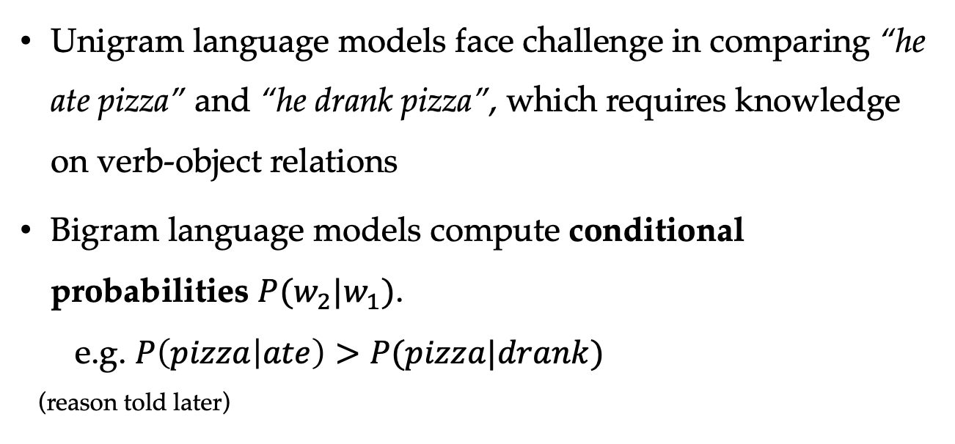
Conditional Probability
Unigram language models face challenge in comparing “he ate pizza” and “he drank pizza”, which requires knowledge on verb-object relations
Bigram language models compute conditional probabilities $P(w_{2}|w_{1})$.
e.g. $P\left(pizza | ate\right)>P(pizza|drank)$
(reason told later)

Slide 29

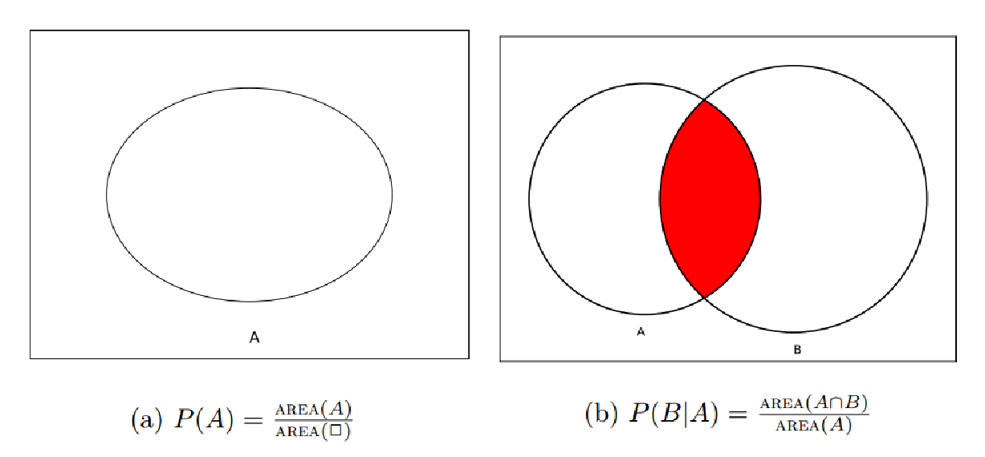
Bigram Probabilities
Training data: D consisting of a set of sentences
Given D: MLE for the conditional probabilities:

Slide 30
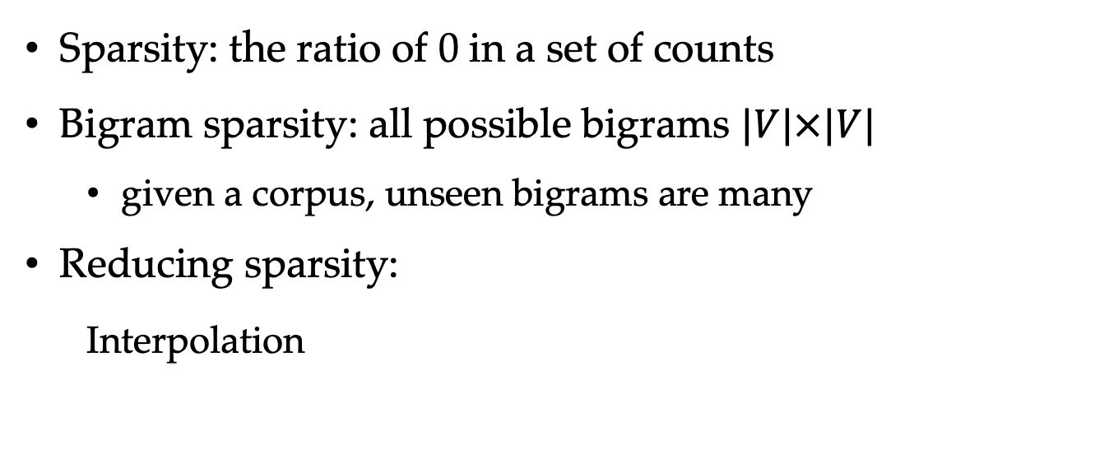
Training Bigram Language Models
Sparsity: the ratio of 0 in a set of counts
Bigram sparsity: all possible bigrams $|V|×|V|$
  given a corpus, unseen bigrams are many
Reducing sparsity:
Interpolation
  $λ$ is a hyper-parameter which can be set empirically.

Slide 31
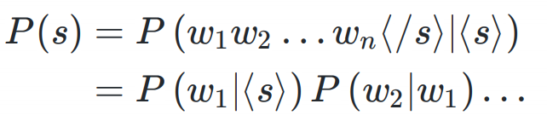

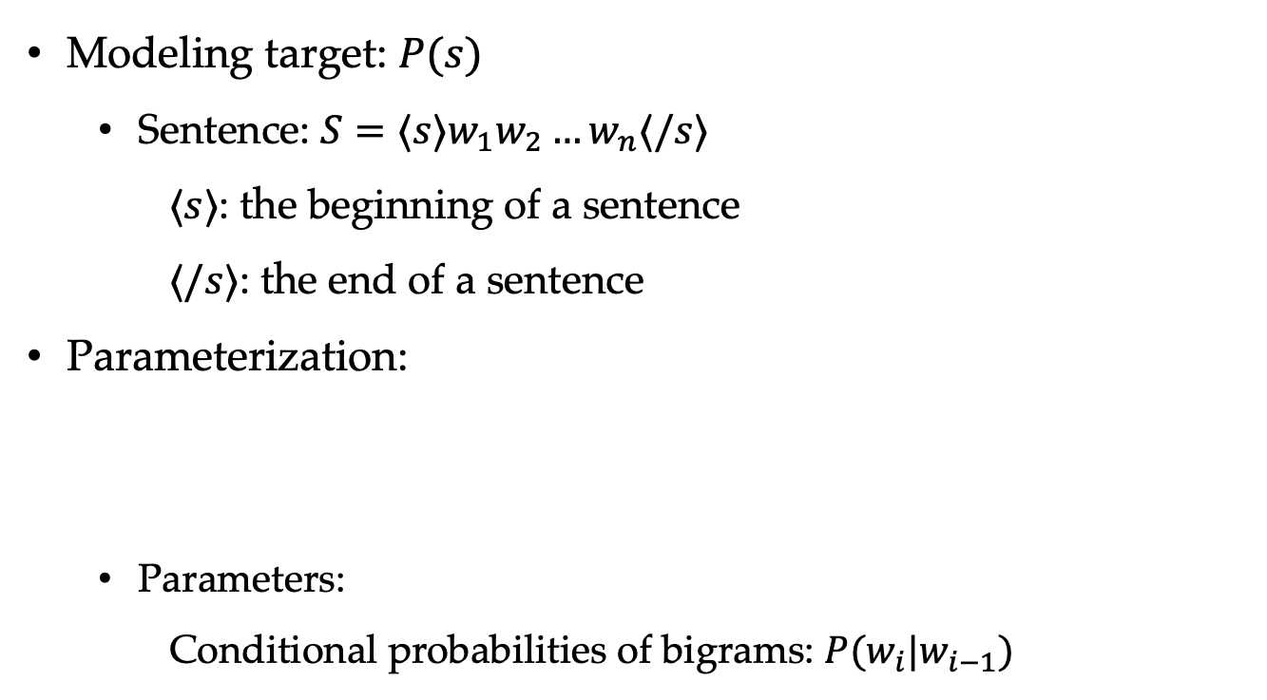
Calculating the Probability of a Sentence
Modeling target: $P(s)$
  Sentence: $S=⟨s⟩w_{1}w_{2}…w_{n}⟨/s⟩$
$⟨s⟩$: the beginning of a sentence
$⟨/s⟩$: the end of a sentence
Parameterization:
  Parameters:
Conditional probabilities of bigrams: $P(w_{i}|w_{i−1})$

Slide 32
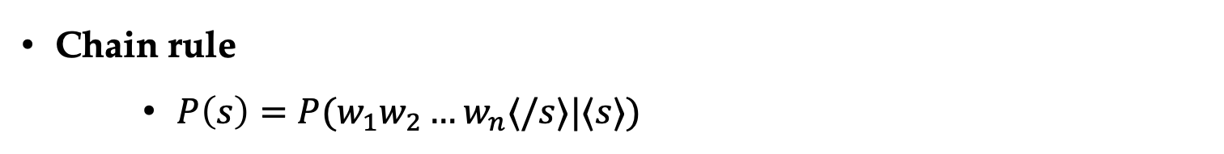
Derivation
Chain rule
    $P\left(s\right)=P(w_{1}w_{2}…w_{n}⟨/s⟩|⟨s⟩)$
    $$=P\left(w_{1} | ⟨s⟩\right)P\left(w_{2} | ⟨s⟩w_{1}\right)…P(⟨/s⟩|\left\langle s\right\rangle w_{1}w_{2}…w_{n})$$

Slide 33
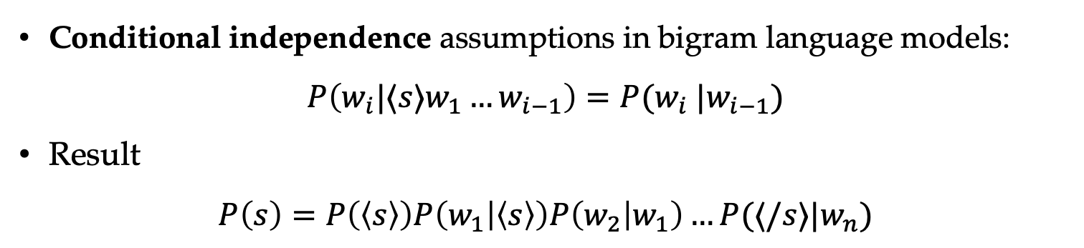
Derivation
Chain rule
    $P\left(s\right)=P(w_{1}w_{2}…w_{n}⟨/s⟩|⟨s⟩)$
    $$=P\left(w_{1} | ⟨s⟩\right)P\left(w_{2} | ⟨s⟩w_{1}\right)…P(⟨/s⟩|\left\langle s\right\rangle w_{1}w_{2}…w_{n})$$
Conditional independence assumptions in bigram language models:
$$P\left(w_{i}|⟨s⟩w_{1}…w_{i−1}\right)=P(w_{i} |w_{i−1})$$
Result
$$P\left(s\right)=P\left(\left\langle s\right\rangle \right)P\left(w_{1} | \left\langle s\right\rangle \right)P\left(w_{2} | w_{1}\right)…P(⟨/s⟩|w_{n})$$

Slide 34
Contents
3.1 Probabilistic Modelling
  3.1.1 Maximum Likelihood Estimation (MLE)
  3.1.2 Modelling the Probability of Words
3.2 N-gram Language Models
  3.2.1 Unigram Language Models
  3.2.2 Bigram Language Models
  3.2.3 Trigram Language Models and Beyond
  3.2.4 Generative Models
3.3 Naïve Bayes Text Classification
  3.3.1 Naïve Bayes Text Classification
  3.3.2 Features

Slide 35
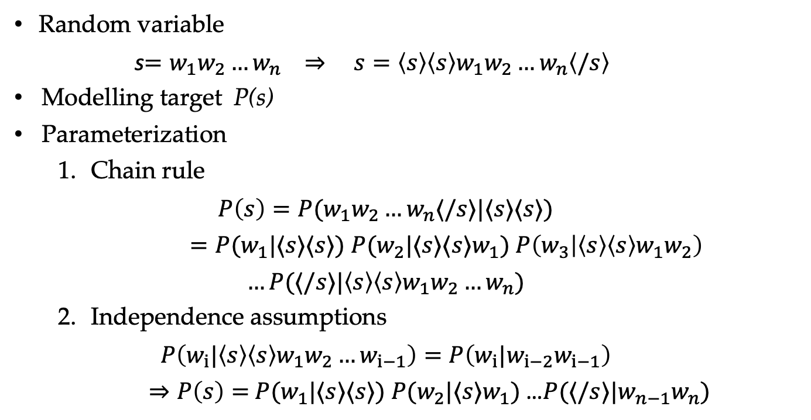
Trigram Language Modelling
Random variable
s$=w_{1}w_{2}…w_{n} ⇒ s=\left\langle s\right\rangle \left\langle s\right\rangle w_{1}w_{2}…w_{n}\left\langle /s\right\rangle$
Modelling target P(s)
Parameterization
  Chain rule
  $$P\left(s\right)=P(w_{1}w_{2}…w_{n}⟨/s⟩|⟨s⟩⟨s⟩)$$
  $=P(w_{1}|⟨s⟩⟨s⟩)$ $P(w_{2}|⟨s⟩⟨s⟩w_{1})$ $P\left(w_{3} | \left\langle s\right\rangle \left\langle s\right\rangle w_{1}w_{2}\right)$
  $$…P(⟨/s⟩|\left\langle s\right\rangle \left\langle s\right\rangle w_{1}w_{2}…w_{n})$$
  Independence assumptions
  $$P\left(w_{i}|{\left\langle s\right\rangle \left\langle s\right\rangle w}_{1}w_{2}…w_{i−1}\right)=P\left(w_{i}|w_{i−2}w_{i−1}\right)$$
  $⇒P\left(s\right)=$ $P(w_{1}|⟨s⟩⟨s⟩)$ $P(w_{2}|⟨s⟩w_{1})$ …$P(⟨/s⟩|{w_{n−1}w}_{n})$

Slide 36
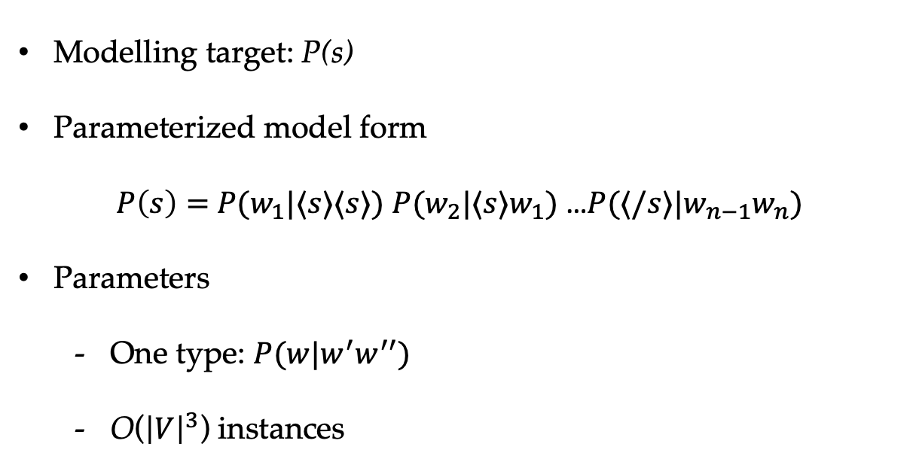
Trigram Language Modelling
Modelling target: P(s)
Parameterized model form
$P\left(s\right)=$ $P(w_{1}|⟨s⟩⟨s⟩)$ $P(w_{2}|⟨s⟩w_{1})$ …$P(⟨/s⟩|{w_{n−1}w}_{n})$
Parameters
  One type: $P(w|w^{′}w^{′′})$
  O(${\left|V\right|}^{3}$) instances

Slide 37
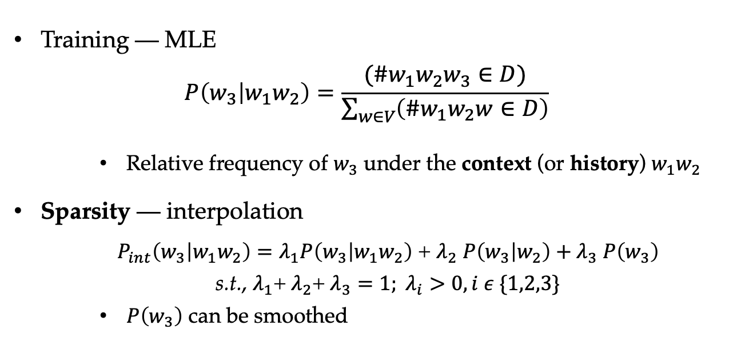
Trigram Language Modelling
Training — MLE
$$P\left(w_{3} | w_{1}w_{2}\right)=\frac{(\#w_{1}w_{2}w_{3}∈D)}{\sum_{w∈V}{\left(\#w_{1}w_{2}w∈D\right)}}$$
    Relative frequency of $w_{3}$ under the context (or history) $w_{1}w_{2}$
Sparsity — interpolation
  $P_{int}\left(w_{3} | w_{1}w_{2}\right)=λ_{1}P\left(w_{3} | w_{1}w_{2}\right)$ + $λ_{2}$ $P\left(w_{3} | w_{2}\right)+λ_{3} P\left(w_{3}\right)$
  s.t., $λ_{1}$+ $λ_{2}$+ $λ_{3}=1; λ_{i}>0, i ε \{1,2,3\}$
    $P\left(w_{3}\right)$ can be smoothed

Slide 38
Methods to Address Sparsity
add-one smoothing: add one to the count of all words
add-α smoothing: add α to the count of all words
Interpolation: use lower order n-gram probabilities to approximate high order n-gram probabilities
back-off: recursive
Good-Turing smoothing: make a rational guess of the count of OOV words
Knesser-Ney smoothing: work with back-off, consider the history context of lower order n-gram

Slide 39
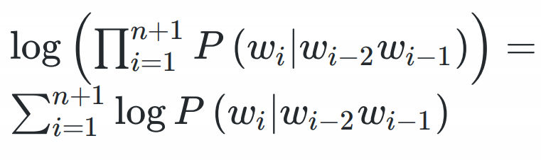
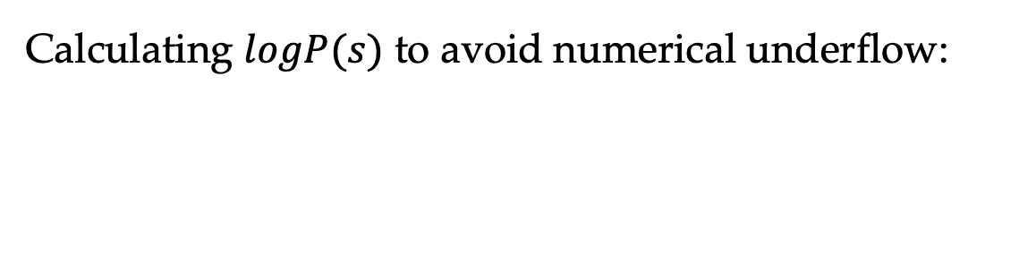
Log-probability Models
Calculating $logP(s)$ to avoid numerical underflow:

Slide 40



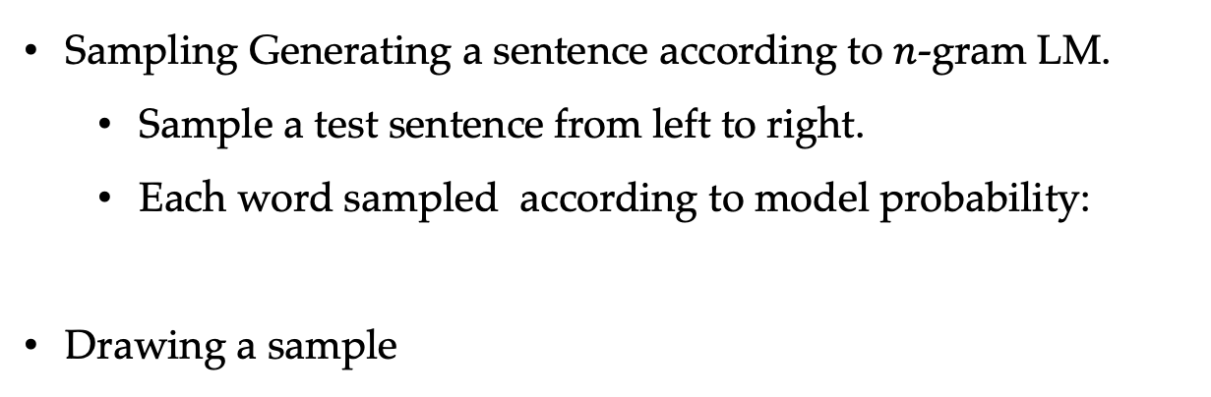

Log-probability Models
Sampling Generating a sentence according to $n$-gram LM.
  Sample a test sentence from left to right.
  Each word sampled according to model probability:
Drawing a sample
random number
0
1
0
$$P(w_{1})$$
$$P(w_{2})$$
$$⋯$$
$$P(w_{|V|})$$
1
vocabulary words

Slide 41
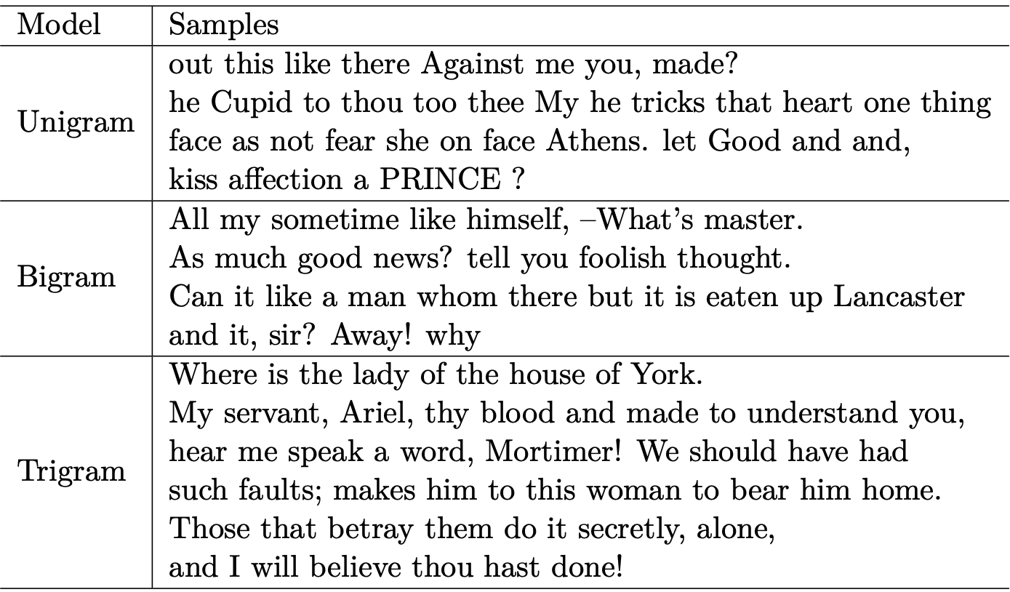
Shakespeare Play

Slide 42
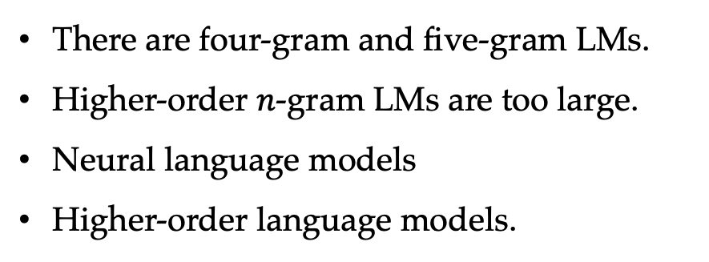
Shakespeare Play
There are four-gram and five-gram LMs.
Higher-order $n$-gram LMs are too large.
Neural language models
Higher-order language models.

Slide 43
Contents
3.1 Probabilistic Modelling
  3.1.1 Maximum Likelihood Estimation (MLE)
  3.1.2 Modelling the Probability of Words
3.2 N-gram Language Models
  3.2.1 Unigram Language Models
  3.2.2 Bigram Language Models
  3.2.3 Trigram Language Models and Beyond
  3.2.4 Generative Models
3.3 Naïve Bayes Text Classification
  3.3.1 Naïve Bayes Text Classification
  3.3.2 Features

Slide 44
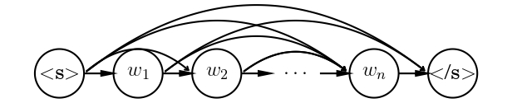

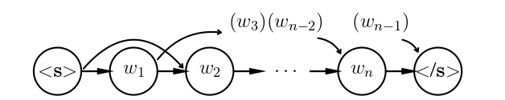
Generative Models
Generative models calculate the probability of a joint event by generating sub events in certain order.
Generative story: a selection is generated left-to-right (probability chain rule)
  First-order Markov model (independence assumption)
  Second-order Markov model (independence assumption)

Slide 45
Contents
3.1 Probabilistic Modelling
  3.1.1 Maximum Likelihood Estimation (MLE)
  3.1.2 Modelling the Probability of Words
3.2 N-gram Language Models
  3.2.1 Unigram Language Models
  3.2.2 Bigram Language Models
  3.2.3 Trigram Language Models and Beyond
  3.2.4 Generative Models
3.3 Naïve Bayes Text Classification
  3.3.1 Naïve Bayes Text Classification
  3.3.2 Features

Slide 46
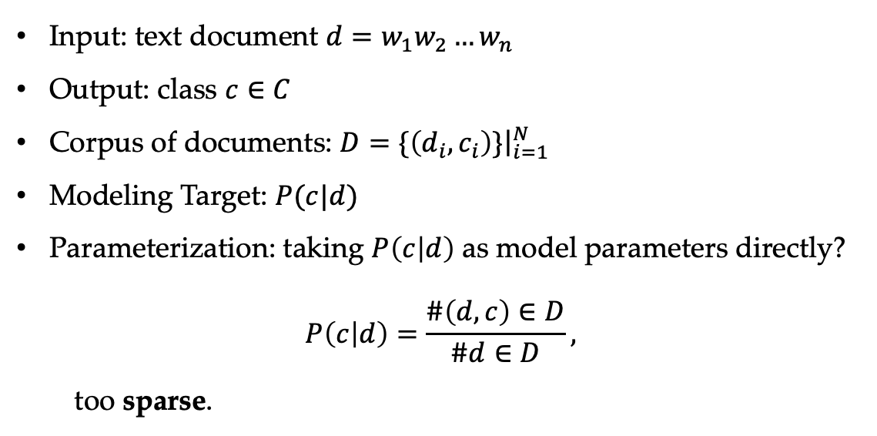
A Probability Model for Text Classification
Input: text document $d=w_{1}w_{2}…w_{n}$
Output: class $c∈C$
Corpus of documents: $D=\{\left(d_{i},c_{i}\right)\}{\left.​\right|}_{i=1}^{N}$
Modeling Target: $P(c|d)$
Parameterization: taking $P\left(c | d\right)$ as model parameters directly?
$$P\left(c | d\right)=\frac{\#\left(d,c\right)∈D}{\#d∈D},$$
too sparse.

Slide 47
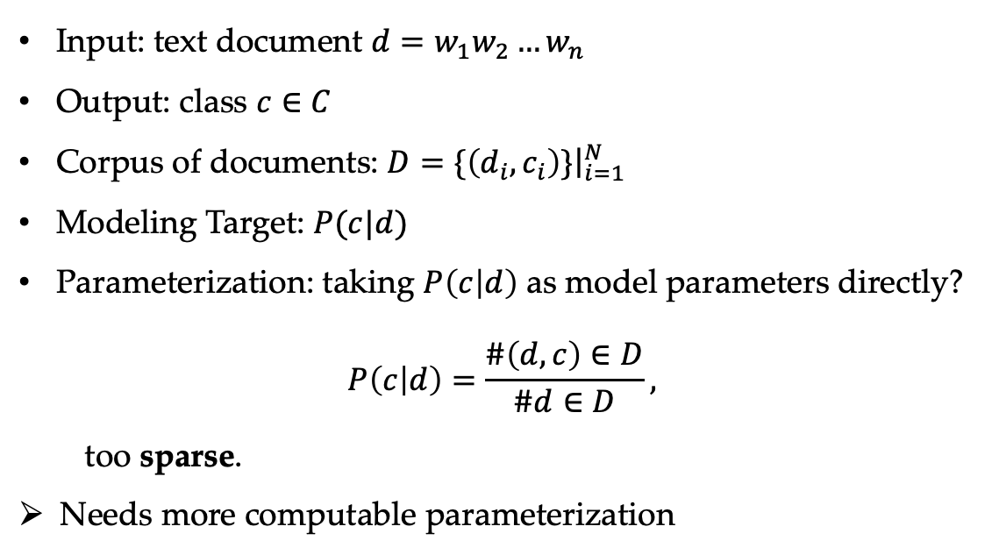
A Probability Model for Text Classification
Input: text document $d=w_{1}w_{2}…w_{n}$
Output: class $c∈C$
Corpus of documents: $D=\{\left(d_{i},c_{i}\right)\}{\left.​\right|}_{i=1}^{N}$
Modeling Target: $P(c|d)$
Parameterization: taking $P\left(c | d\right)$ as model parameters directly?
$$P\left(c | d\right)=\frac{\#\left(d,c\right)∈D}{\#d∈D},$$
too sparse.
Needs more computable parameterization

Slide 48
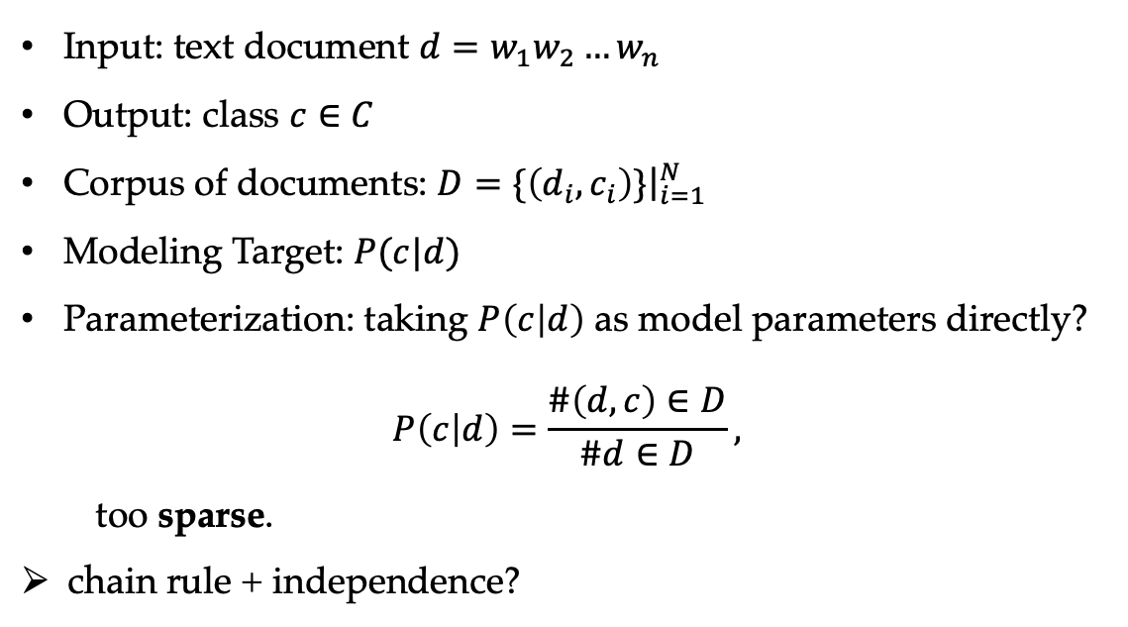
A Probability Model for Text Classification
Input: text document $d=w_{1}w_{2}…w_{n}$
Output: class $c∈C$
Corpus of documents: $D=\{\left(d_{i},c_{i}\right)\}{\left.​\right|}_{i=1}^{N}$
Modeling Target: $P(c|d)$
Parameterization: taking $P\left(c | d\right)$ as model parameters directly?
$$P\left(c | d\right)=\frac{\#\left(d,c\right)∈D}{\#d∈D},$$
too sparse.
chain rule + independence?

Slide 49
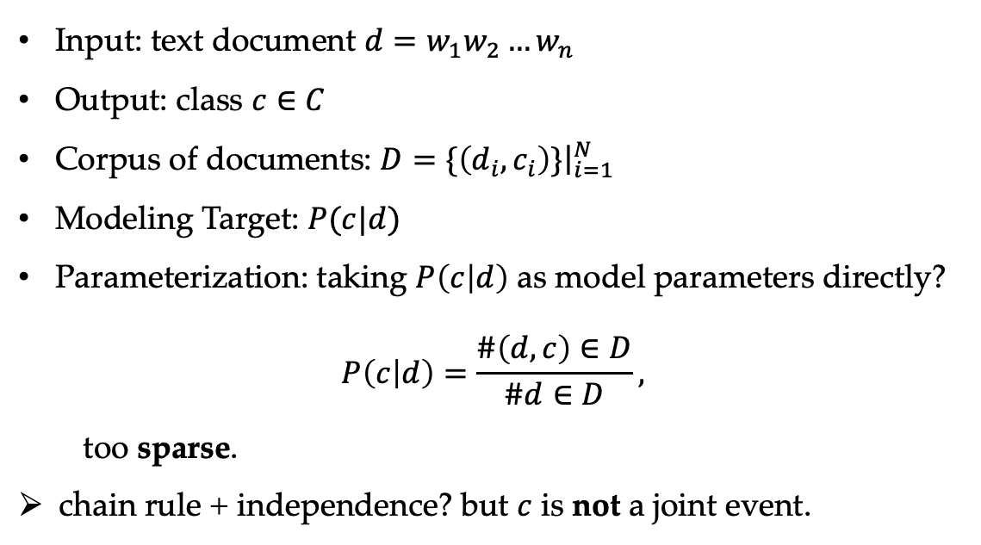
A Probability Model for Text Classification
Input: text document $d=w_{1}w_{2}…w_{n}$
Output: class $c∈C$
Corpus of documents: $D=\{\left(d_{i},c_{i}\right)\}{\left.​\right|}_{i=1}^{N}$
Modeling Target: $P(c|d)$
Parameterization: taking $P\left(c | d\right)$ as model parameters directly?
$$P\left(c | d\right)=\frac{\#\left(d,c\right)∈D}{\#d∈D},$$
too sparse.
chain rule + independence? but $c$ is not a joint event.

Slide 50
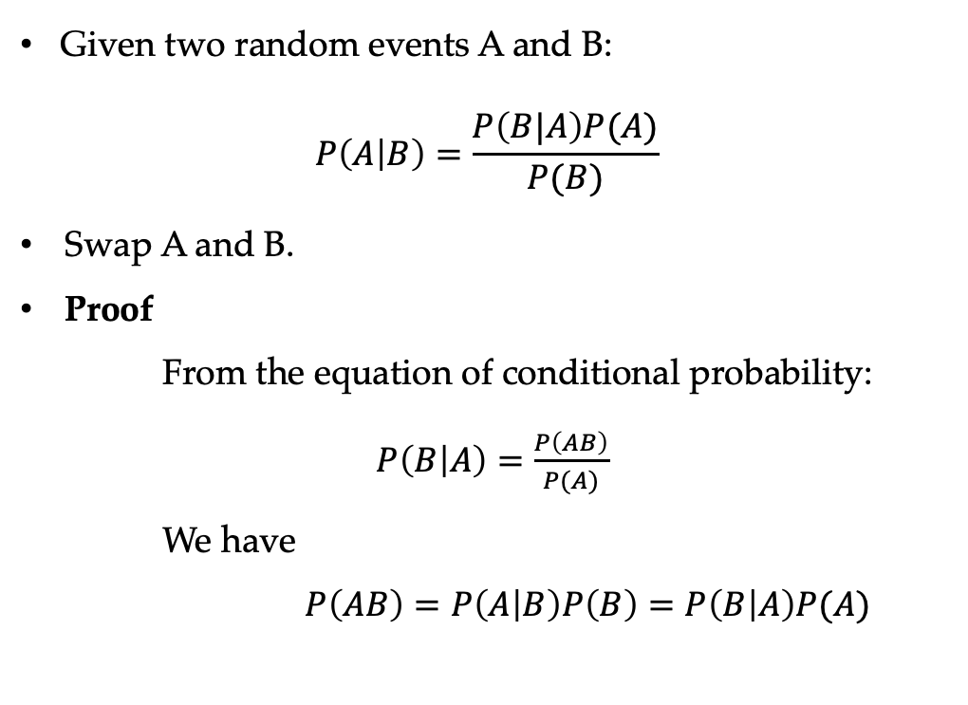
The Bayes Rule Review
Given two random events A and B:
$$P\left(A | B\right)=\frac{P\left(B|A\right)P(A)}{P(B)}$$
Swap A and B.
Proof
    From the equation of conditional probability:
    $P\left(B | A\right)=\frac{P\left(AB\right)}{P(A)}$
    We have
    $P\left(AB\right)=P\left(A | B\right)P\left(B\right)=P\left(B | A\right)P(A)$

Slide 51
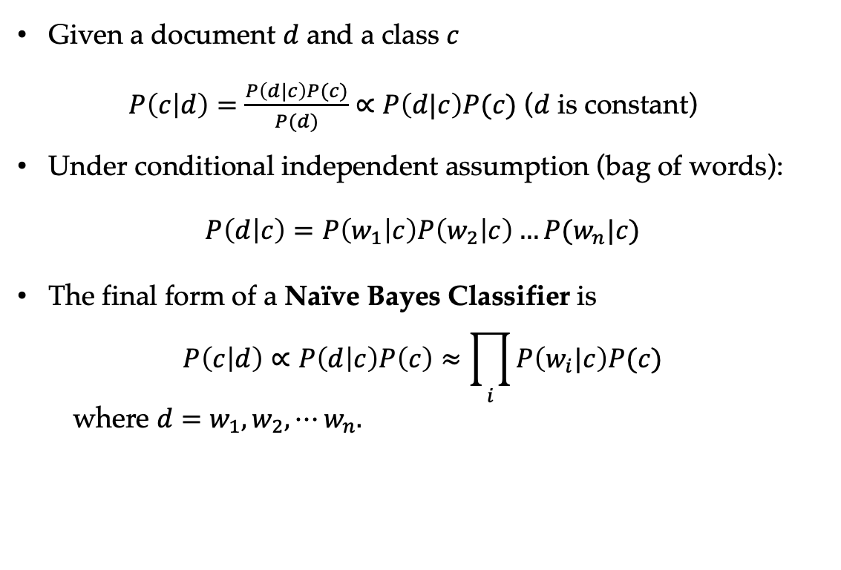
The Naïve Bayes Model
Given a document $d$ and a class $c$
$P\left(c | d\right)=\frac{P\left(d|c\right)P(c)}{P(d)}∝$ $P\left(d|c\right)P(c)$ ($d$ is constant)
Under conditional independent assumption (bag of words):
$$P\left(d | c\right)=P\left(w_{1} | c\right)P\left(w_{2} | c\right)…P(w_{n}|c)$$
The final form of a Naïve Bayes Classifier is
$$P\left(c | d\right)∝P\left(d | c\right)P\left(c\right)≈\prod_{i}{P\left(w_{i}|c\right)P(c)}$$
where $d=w_{1}, w_{2},⋯w_{n}.$

Slide 52
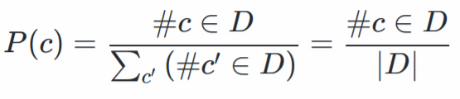
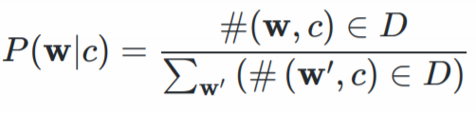
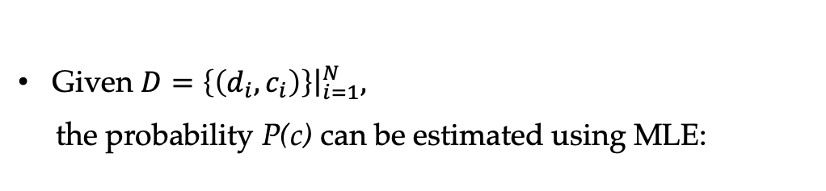
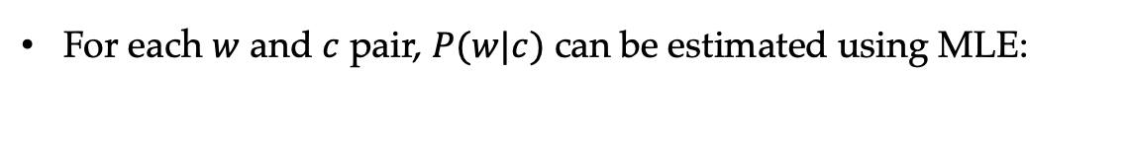
Training a Naïve Bayes Classifier
Given $D=\left\{\left(d_{i},c_{i}\right)\right\}{\left.​\right|}_{i=1}^{N},$
the probability P(c) can be estimated using MLE:
For each $w$ and $c$ pair, $P(w|c)$ can be estimated using MLE:

Slide 53
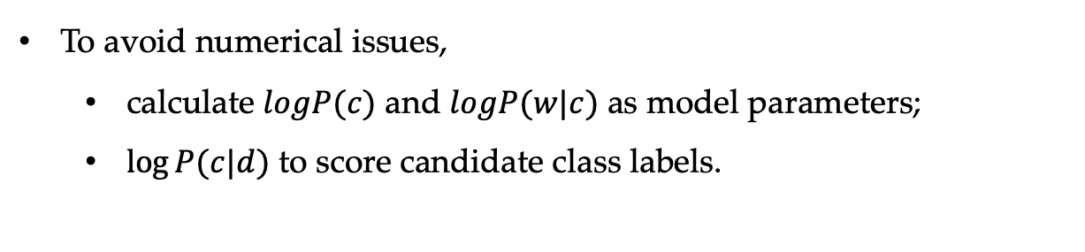
Training a Naïve Bayes Classifier
Given $D=\left\{\left(d_{i},c_{i}\right)\right\}{\left.​\right|}_{i=1}^{N},$
the probability P(c) can be estimated using MLE:
For each $w$ and $c$ pair, $P(w|c)$ can be estimated using MLE:
To avoid numerical issues,
  calculate $logP(c)$ and $logP(w|c)$ as model parameters;
  $log⁡P(c|d)$ to score candidate class labels.

Slide 54
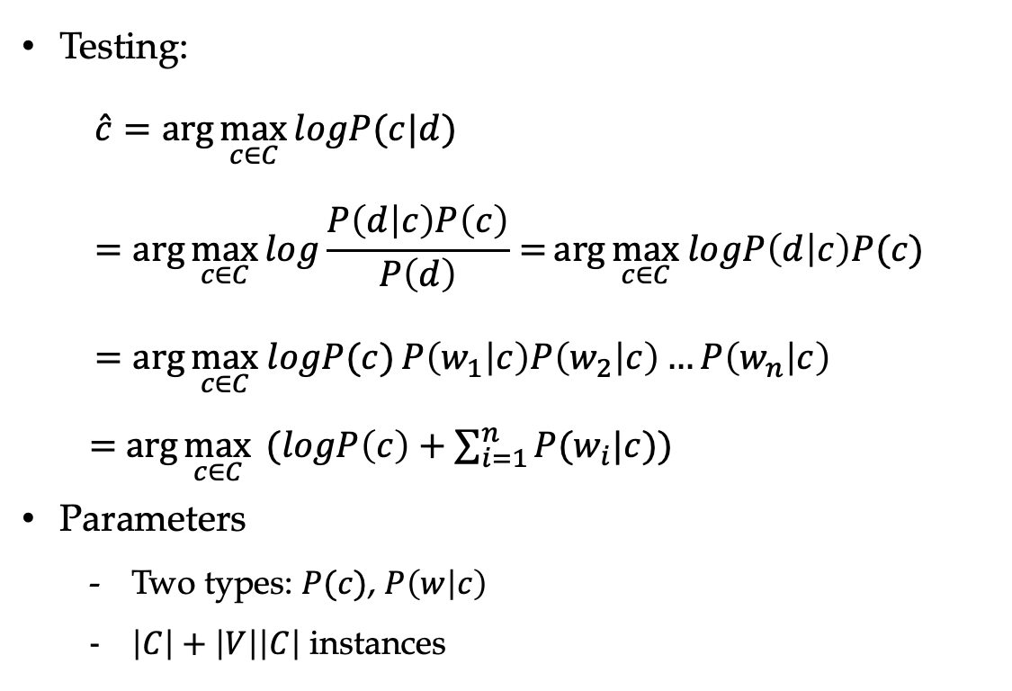
Naïve Bayes Text Classification
Testing:
$$\hat{c}=\arg{\max_{c∈C}{logP(c|d) }} =\arg{\max_{c∈C}{log\frac{P\left(d | c\right)P\left(c\right)}{P\left(d\right)}=}\arg{\max_{c∈C} logP\left(d | c\right)P(c)}}=\arg{\max_{c∈C} logP(c)}P\left(w_{1} | c\right)P\left(w_{2} | c\right)…P\left(w_{n} | c\right)$$
$=$ $\arg{\max_{c∈C} }(logP\left(c\right)+\sum_{i=1}^{n}{P(w_{i}|c)})$
Parameters
  Two types: $P(c)$, $P\left(w | c\right)$
  $\left|C\right|+\left|V\right|\left|C\right|$ instances
54

Slide 55
Generative Story
  (a) Naïve Bayes model
  (b) Naïve Bayes model (nested plate notation)
55

Slide 56
Contents
3.1 Probabilistic Modelling
  3.1.1 Maximum Likelihood Estimation (MLE)
  3.1.2 Modelling the Probability of Words
3.2 N-gram Language Models
  3.2.1 Unigram Language Models
  3.2.2 Bigram Language Models
  3.2.3 Trigram Language Models and Beyond
  3.2.4 Generative Models
3.3 Naïve Bayes Text Classification
  3.3.1 Naïve Bayes Text Classification
  3.3.2 Features

Slide 57
Features in NLP
Features are patterns that are used to parameterize a model
  word: P(w)
  class: P(c)
  n-gram: P(w₂|w₁), P(w₃|w₁ w₂)
  word-class pair: P(w|c)
With more features, we can obtain more evidences for making a correct prediction
But we cannot use overlapping features for generative models (e.g., P(w), P(w|c)), because each event is generated once.

Slide 58
Summary
Parametrization of a probability model
  Bayes rule
  Chain rule
  Probability independence
Maximum likelihood estimation
N-gram language models
Naive Bayes models for text classification
Generative models

